Slide 1
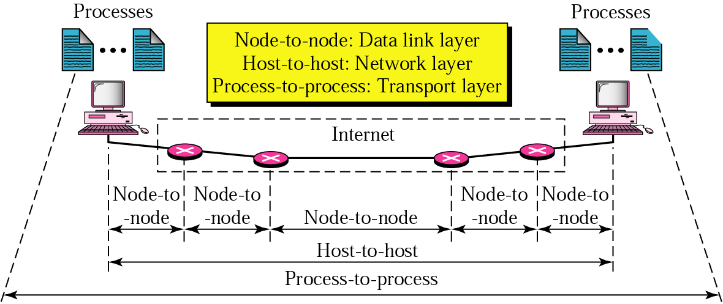
Topic 5: End-to-End Protocol
Notes:
Image Credit: Behroze Forouzan; Notes Credit: Peterson and Davie
The previous three topics covered in the lectures have described various technologies that can be used to connect together a collection of computers: direct links (including LAN technologies like Ethernet and token ring), packet-switched networks (including cell-based networks like ATM), and internetworks. The next problem is to turn this host-to-host packet delivery service into a process-to-process communication channel.
This is the role played by the transport level of the network architecture, which, because it supports
communication between the end application programs, is sometimes called the end-to-end protocol.
The end-to-end protocols will be next topic we’d cover in our Computer Networks Class.

Slide 2
Topic’s objectives
To learn about:
1) How transmissions are triggered in TCP?
2 – How does TCP use re-adaptive transmission?
Notes:
Today we’d be seeing what are the primary objectives/ functions of an end-to-end transport layer protocol.
We’d also be seeing two common TCP/ IP end-to-end transport protocols that provide contrasting services: the first (UDP) provides a simple demultiplexing service and the other (TCP) provides a reliable byte stream service.

Slide 3
Transmission Triggering
in TCP
1

Slide 4
TCP = reliable byte stream
Recap
… emulated using TCP Segments
Sender
Byte 0
Byte 1
Byte 2
Byte 3
Byte 80
Segment sent when:
Segment full (Max Segment Size),
Not full, but times out, or
Pushed by application.
TCP Segment
TCP Segment
Byte 0
Byte 1
Byte 2
Byte 3
Byte 80
Receiver
Notes:
If we ignore the possibility of flow control—that is, we assume the window is wide open, as would be the case when a connection first starts—then TCP has three mechanisms to trigger the transmission of a segment.
First, TCP maintains a variable, typically called the maximum segment size (MSS), and it sends a segment as soon as it has collected MSS bytes from the sending process. MSS is usually set to the size of the largest segment TCP can send without causing the local IP to fragment. That is, MSS is set to the MTU of the directly connected network, minus the size of the TCP and IP headers.
Second, TCP will be triggered to transmit a segment if the sending process has explicitly asked it to do so. Specifically, TCP supports a push operation, and the sending process invokes this operation to effectively flush the buffer of unsent bytes.
Third, the final trigger for transmitting a segment is that a timer fires; the resulting segment contains as many bytes as are currently buffered for transmission. However, as we will soon see, this “timer” isn’t exactly what you expect.

Slide 5
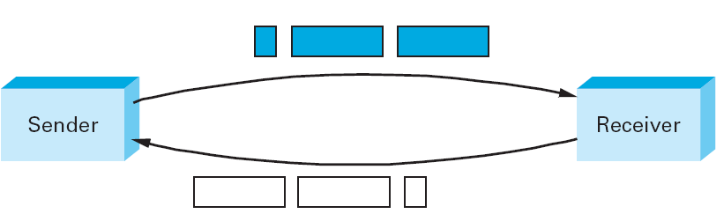
Silly Window Syndrome
Notes:
Of course, we can’t just ignore flow control, which plays an obvious role in throttling the sender. If the sender has MSS bytes of data to send and the window is open at least that much, then the sender transmits a full segment. Suppose, however, that the sender is accumulating bytes to send, but the window is currently closed. Now suppose an ACK arrives that effectively opens the window enough for the sender to transmit, say, MSS/2 bytes. Should the sender transmit a half-full segment or wait for the window to open to a full MSS? The original specification was silent on this point, and early implementations of TCP decided t o go ahead and transmit a half-full segment. After all, there is no telling how long it will be before the window opens further. It turns out that the strategy of aggressively taking advantage of any available window leads to a situation now known as the silly window syndrome.
The figure above helps visualize what happens. If you think of a TCP stream as a conveyer belt with “full” containers (data segments) going in one direction and empty containers (ACKs) going in the reverse direction, then MSS-sized segments correspond to large containers and 1-byte segments correspond to very small containers. If the sender aggressively fills an empty container as soon as it arrives, then any small container introduced into the system remains in the system indefinitely. That is, it is immediately filled and emptied at each end, and never coalesced with adjacent containers to create larger containers. This scenario was discovered when early implementations of TCP regularly found themselves filling the network with tiny segments.
Note that the silly window syndrome is only a problem when either the sender transmits a small segment or the receiver opens the window a small amount.
If neither of these happens, then the small container is never introduced into the stream. It’s not possible to outlaw sending small segments; for example, the application might do a push after sending a single byte. It is possible, however, to keep the receiver from introducing a small container (i.e., a small open window). The rule is that after advertizing a zero window, the receiver must wait for space equal to an MSS before it advertises an open window.
Coalescing Segments: Since we can’t eliminate the possibility of a small container being introduced into the stream, we also need mechanisms to coalesce them. The receiver can do this by delaying ACKs—sending one combined ACK rather than multiple smaller ones—but this is only a partial solution because the receiver has no way of knowing how long it is safe to delay waiting either for another segment to arrive or for the application to read more data (thus opening the window). The ultimate solution falls to the sender, which brings us back to our original issue: When does the TCP sender decide to transmit a segment?

Slide 6
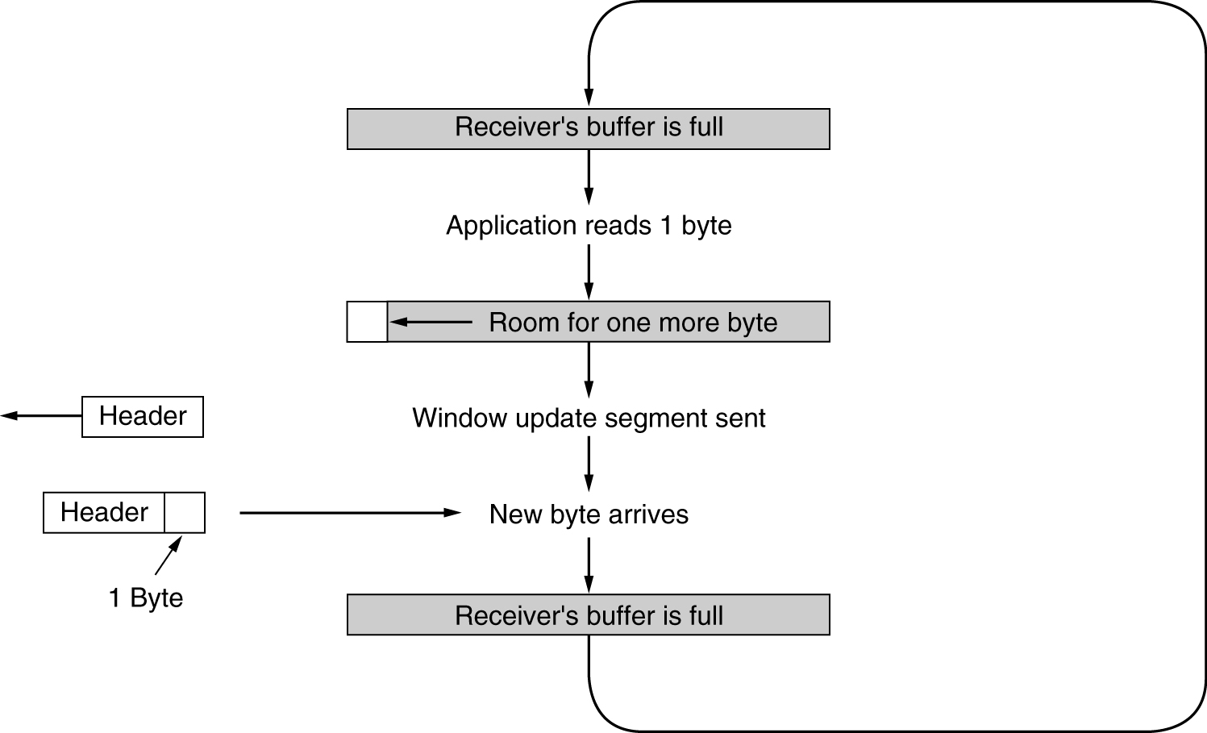
Clark’s Algorithm – Receiver side
Advertise at least MSS or buffer-space/2 (whichever is minimum) after advertising Window = 0
Notes:
Clark's solution is to prevent the receiver from sending a window update for 1 byte. Instead it is forced to wait until it has a decent amount of space available and advertise that instead. Specifically, the receiver should not send a window update until it can handle the maximum segment size it advertised when the connection was established or until its buffer is half empty, whichever is smaller.

Slide 7
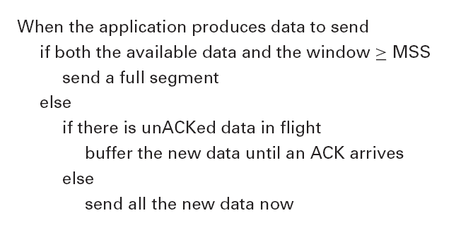
Nagle’s Algorithm – Sender side
Works at coalescing small sized TCP segments
Notes:
Returning to the TCP sender, if there is data to send but the window is open less than MSS, then we may want to wait some amount of time before sending the available data, but the question is, how long? If we wait too long, then we hurt interactive applications like Telnet. If we don’t wait long enough, then we risk sending a bunch of tiny packets and falling into the silly window syndrome. The answer is to introduce a “timer” and to transmit when the timer expires.
While we could use a clock-based timer—for example, one that fires every 100 ms—Nagle introduced an elegant self-clocking solution. The idea is that as long as TCP has any data in flight, the sender will eventually receive an ACK. This ACK can be treated like a timer firing, triggering the transmission of more data. Nagle’s algorithm provides a simple, unified rule for deciding when to transmit (shown above).
In other words, it’s always OK to send a full segment if the window allows. It’s also OK to immediately send a small amount of data if there are currently no
segments in transit, but if there is anything in flight, the sender must wait for an ACK before transmiting the next segment. Thus, an interactive application like Telnet that continually writes one byte at a time will send data at a rate of one segment per RTT. Some segments will contain a single byte, while others will contain as many bytes as the user was able to type in one round-trip time. Because some applications cannot afford such a delay for each write they do to a TCP connection, the socket interface allows applications to turn off Nagle’s algorithm by setting the TCP NODELAY option. Setting this option means that data is transmitted as soon as possible.

Slide 8
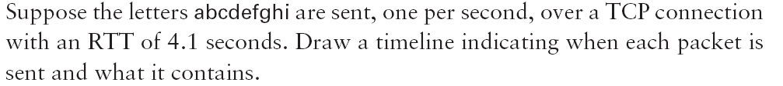
Nagle’s Algorithm
Textbook Exercise: Chapter 5; Q 20 a)
T=0.0: ‘a’ sent
T=1.0: ‘b’ collected in buffer
T=2.0: ‘c’ collected in buffer
T=3.0: ‘d’ collected in buffer
T=4.0: ‘e’ collected in buffer
T=4.1: ACK of ‘a’ arrives, “bcde” sent
T=5.0: ‘f’ collected in buffer
T=6.0: ‘g’ collected in buffer
T=7.0: ‘h’ collected in buffer
T=8.0: ‘i’ collected in buffer
T=8.2: ACK arrives; “fghi” sent

Slide 9
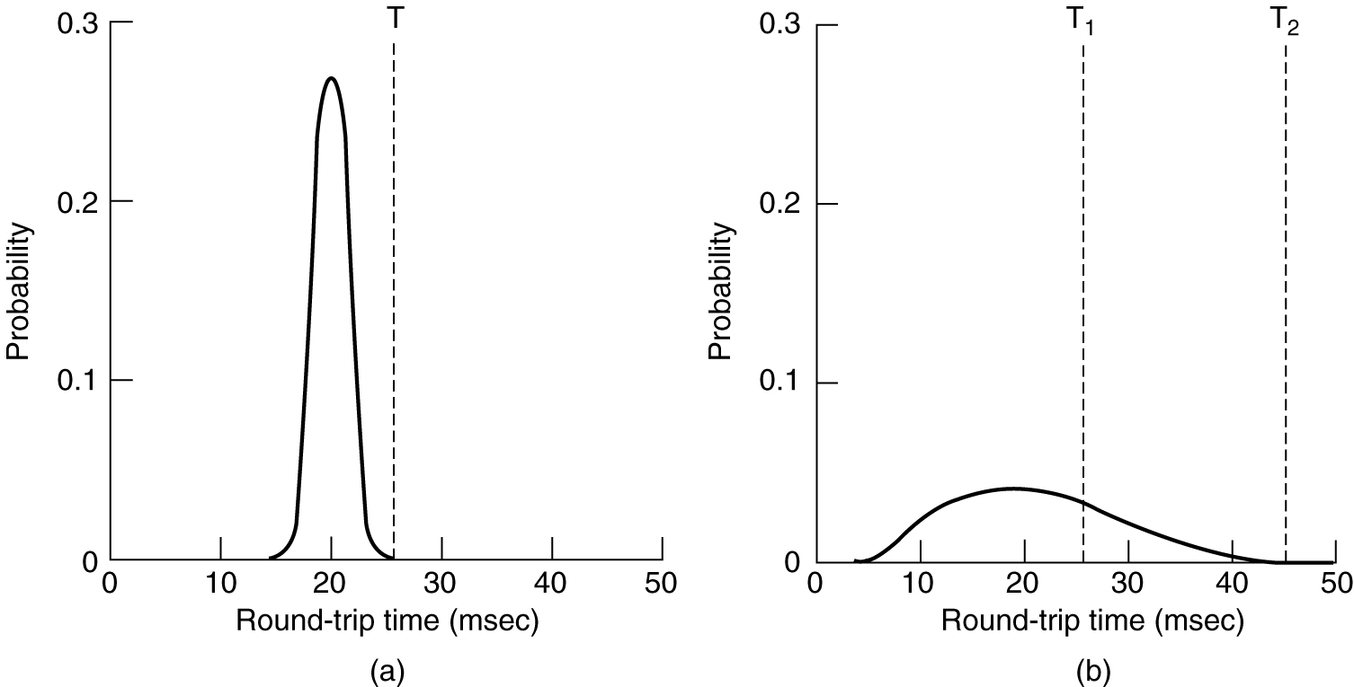
Adaptive Retransmissions
in TCP
2
Data link layer
TCP
Notes:
Because TCP guarantees the reliable delivery of data, it retransmits each segment if an ACK is not received in a certain period of time. TCP sets this timeout as a function of the RTT it expects between the two ends of the connection. Unfortunately, given the range of possible RTTs between any pair of hosts in the Internet, as well as the variation in RTT between the same two hosts over time, choosing an appropriate timeout value is not that easy. To address this problem, TCP uses an adaptive retransmission mechanism. We now describe this mechanism and how it has evolved over time as the Internet community has gained more experience using TCP.

Slide 10
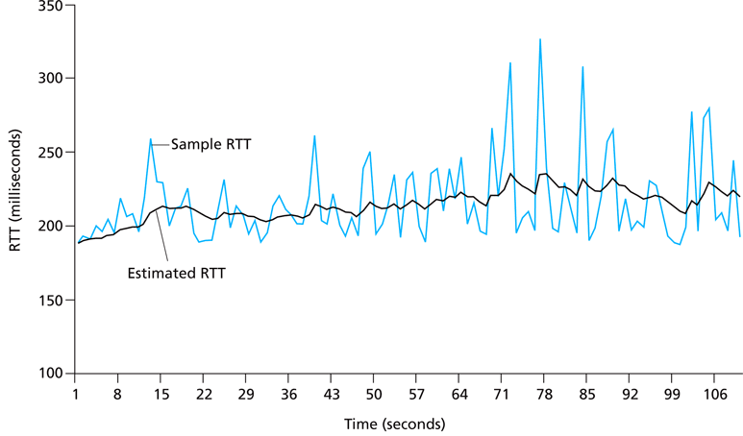
TCP’s Original Algorithm
= (1-α). Estimated RTT + α. Sample RTT
Timeout interval (RTO)= 2 x Estimated RTT
Notes:
We begin with a simple algorithm for computing a timeout value between a pair of hosts. This is the algorithm that was originally described in the TCP specification— and the following description presents it in those terms—but it could be used by any end-to-end protocol.
The idea is to keep a running average of the RTT and then to compute the timeout as a function of this RTT. Specifically, every time TCP sends a data segment, it records the time. When an ACK for that segment arrives, TCP reads the time again and then takes the difference between these two times as a SampleRTT. TCP then computes an EstimatedRTT as a weighted average between the previous estimate and this new sample. That is,
EstimatedRTT = α × EstimatedRTT + (1 − α) × SampleRTT
The parameter α is selected to smooth the EstimatedRTT. A small α tracks changes in the RTT but is perhaps too heavily influenced by temporary fluctuations. On the other hand, a large α is more stable but perhaps not quick enough to adapt to real changes. The original TCP specification recommended a setting of α between 0.8 and 0.9. TCP then uses EstimatedRTT to compute the timeout in a rather conservative way:
TimeOut = 2 × EstimatedRTT

Slide 11
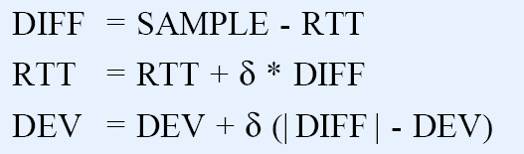

Jacobson/ Karel’s Algorithm
Smoothed RTT takes into account
sample and estimated RTT as well as mean variance of the RTT
Called SRTT (Smoothed RTT) in RFC 2988
Values from 0 to 1
Typical value of 4
Called RTTVAR (Round Trip Time Variation) in RFC 2988
Typical value of 1
Notes:
The Karn/Partridge algorithm was introduced at a time when the Internet was suffering from high levels of network congestion. Their approach was designed to fix some of the causes of that congestion, and although it was an improvement, the congestion was not eliminated. A couple of years later, two other researchers—Jacobson and Karels— proposed a more drastic change to TCP to battle congestion. The bulk of that proposed change is described in the next lecture (Topic 6). Here, we focus on the aspect of that proposal that is related to deciding when to time out and retransmit a segment.
[As an aside, it should be clear how the timeout mechanism is related to congestion—if you time out too soon, you may unnecessarily retransmit a segment,
which only adds to the load on the network. As we will see in the next lecture (topic 6 ; Chapter 6 of the textbook), the other reason for needing an accurate timeout value is that a timeout is taken to imply congestion, which triggers a congestion-control mechanism. Finally, note that there is nothing about the Jacobson/Karels timeout computation that is specific to TCP. It could be used by any end-to-end protocol.]
Difference = SampleRTT − EstimatedRTT
EstimatedRTT = EstimatedRTT + (δ × Difference)
where δ is a fraction between 0 and 1. That is, we calculate both the mean RTT and the variation in that mean.
TCP then computes the timeout value as a function of both EstimatedRTT and
Deviation as follows:
TimeOut = μ × EstimatedRTT + φ × Deviation
where based on experience, μ is typically set to 1 and φ is set to 4. Thus, when the variance is small, TimeOut is close to EstimatedRTT; a large variance causes the Deviation term to dominate the calculation.
The main problem with the original computation is that it does not take the variance of the sample RTTs into account. Intuitively, if the variation among samples
is small, then the EstimatedRTT can be better trusted and there is no reason for multiplying this estimate by 2 to compute the timeout. On the other hand, a large variance in the samples suggests that the timeout value should not be too tightly coupled to the EstimatedRTT.
In the new approach, the sender measures a new SampleRTT as before. It then folds this new sample into the timeout calculation as follows:

Slide 12
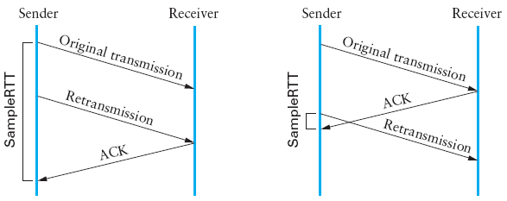
Karn/ Partridge’s Algorithm
Previous approach’s flaw: ACK acks reception not transmission
Overestimation of RTT
Underestimation of RTT
Notes:
After several years of use on the Internet, a rather obvious flaw was discovered in this simple algorithm. The problem was that an ACK does not really acknowledge a transmission; it actually acknowledges the receipt of data. In other words, whenever a segment is retransmitted and then an ACK arrives at the sender, it is impossible to determine if this ACK should be associated with the first or the second transmission of the segment for the purpose of measuring the sample RTT. It is necessary to know which transmission to associate it with so as to compute an accurate SampleRTT. As illustrated in Figure 5.10, if you assume that the ACK is for the original transmission but it was really for the second, then the SampleRTT is too large (a), while if you assume that the ACK is for the second transmission but it was actually for the first, then the SampleRTT is too small (b).
The solution is surprisingly simple. Whenever TCP retransmits a segment, it stops taking samples of the RTT; it only measures SampleRTT for segments that have been sent only once. This solution is known as the Karn/Partridge algorithm, after its inventors.
Their proposed fix also includes a second small change to TCP’s timeout mechanism. Each time TCP retransmits, it sets the next timeout to be twice the last
timeout, rather than basing it on the last EstimatedRTT. That is, Karn and Partridge proposed that TCP use exponential backoff, similar to what the Ethernet does. The motivation for using exponential backoff is simple: Congestion is the most likely cause of lost segments, meaning that the TCP source should not react too aggressively to a timeout. In fact, the more times the connection times out, the more cautious the source should become.

Slide 13

References
Section 5.2:
End-to-End Protocols
[P&D]

Slide 14
?
?
Questions/ Confusions?
?
Use the discussion forum at:
http://compnets.ning.com/
Credits/ Acknowledgement at:
http://sites.google.com/site/cse320site/

